Slide 1
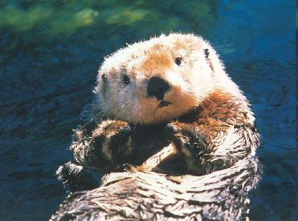
Sea Otters
By: Daniella Farkash

Slide 2
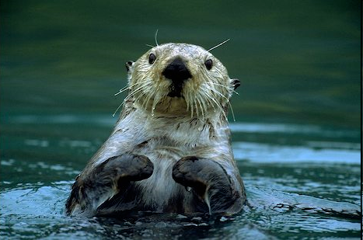
Physical Characteristics
Sea otters have a small round head, closeable nostril, ears with flaps and small eyes that are good for seeing in and out of the water. The nostrils and the ears close while underwater so that no water gets into them.

Slide 3
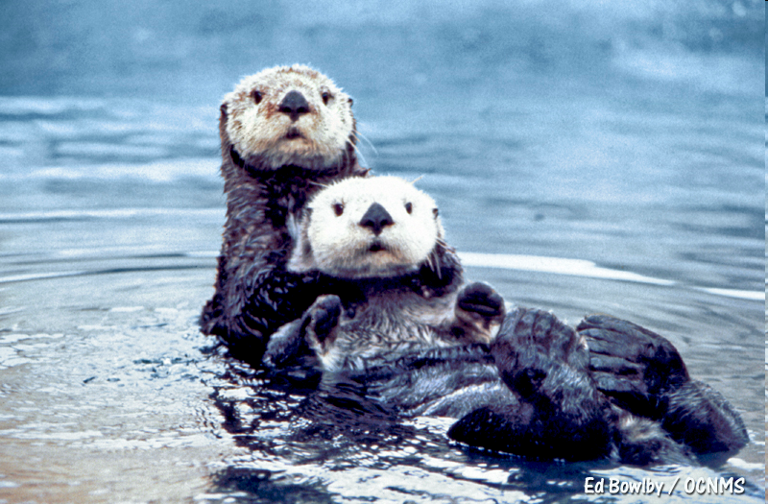
Habitat
Sea otters today live in the Commander islands, the Aleutain islands, Vancouver island, and California. Sea otters no longer live off the coast of Mexico, the Pribilof islands, and Hokkaido because a long time ago too many people killed the sea otters and used the valuable thick fur for trading.

Slide 4
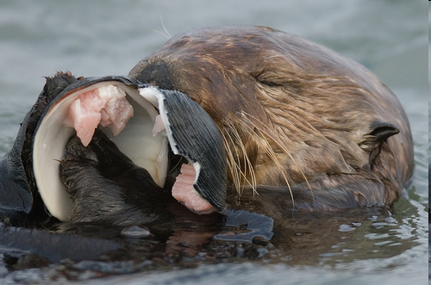
What do they eat
Sea otters mostly eat sea urchins, mussels, abalone, clams, scallops, crabs, sea snails, chitons, octopus and squid. Sea otters use rocks as tools to break open the hard-shelled prey.

Slide 5
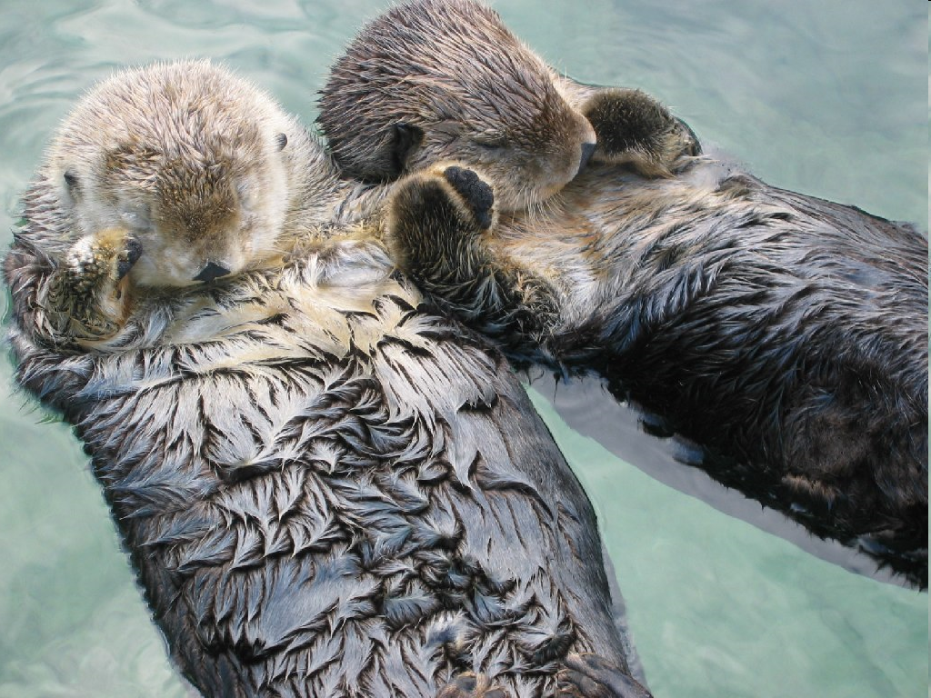
Reproduction
Both male and female otters attain sexual maturity in their second or third year. Most don’t successfully reproduce until they are five or seven years old. At first a male approaches a female.If she doesn’t want a mate, she will hiss or slap the water with her tail and dive. But if she wants a mate she will start to groom and play with him. The mating act only takes a few minutes.

Slide 6
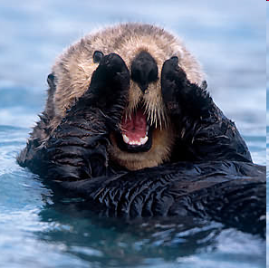
Fun Facts
Did you know sea otters spend much of their lives in the water and dive up to 330 feet when foraging for food. They sometimes rest in coastal kelp forests and often draping the kelp over there bodies to keep from drifting away.

