Slide 1
The Female Reproductive System
By Justine Wilson and Kim Iwanski

Slide 2
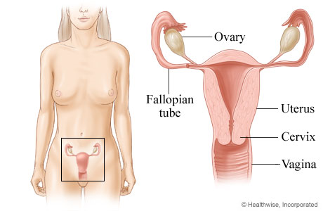
Main Fucntions
To produce the hormones estrogen and progesterone
To reproduce
It is the sight of fetal development

Slide 3
The Ovaries
Functions
Production of Estrogen and Progesterone
Estrogen is the female hormone, it promotes the development of secondary female characteristics and regulates the menstrual cycle
Progesterone is a hormone that is typically associated with pregnancy as it is developed more during pregnancy
Ovulation
Once a month (or in some cases more often) an Ovum (egg cell) is released from an ovary
In the event that one ovary is dysfunctional other will take over both ovulation and hormone production completely , otherwise they will alternate

Slide 4
Ovarian Cysts A collection of fluid surrounded by a thin wall of tissue
Healthy ovary
Cystic Ovary

Slide 5
Most cysts are considered benign, however others can be extremely painful
Symptoms Include:
Nausea
Fatigue
Infertility
Increase In Hair Growth
Bloating

Slide 6
The Fallopian Tubes
Functions
The fallopian tubes lead from the ovaries to the uterus
Finger like projections line the fallopian tubes, the catch and move Ovum along to the uterus
The fallopian tubes are the most common sight of fertilization

Slide 7
Ectopic Pregnancy
Ectopic Pregnancy is a pregnancy that occurs when a fertilized ovum implants in any tissue other than the uterus
Because the fallopian tubes are the most common site of fertilization it is possible for a zygote to implant and grow within the fallopian tubes
Eventually the fetus will grow too large and tear through the fallopian tube. This commonly results in death fro both mother and fetus.
Ectopic Pregnancies must be terminated.

Slide 8
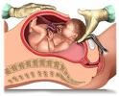
The Uterus
The uterus is a strong muscular organ with the ability to expand itself
It is the sight of fetal development
Also referred to as the womb

Slide 9
Functions
Menstruation: The shedding of the endometrium (uterine lining)
occurs once a month (about every 28 days)
Menstruation occurs as a result of the absence of pregnancy
Menstruation during pregnancy is not normal, although light bleeding is common
There are many physical symptoms and discomforts associated with Menstruation as well as PMS they include, Headache, Vomiting, Nausea, Bloating and Abdominal Pain
The severity of these symptoms differs depending on the woman, some have persistent symptoms while others do not experience any at all.

Slide 10
Pregnancy
After implanting in the uterus, a fertilized ovum begins to develop into a human being. The gestation period is about 39 weeks. During this time the uterus expands to make room for the growing fetus, this causes other organs above the uterus to move upwards. It is believed that this unsettling movement of organs (including the stomach) that causes persistent vomiting during pregnancy.

Slide 11
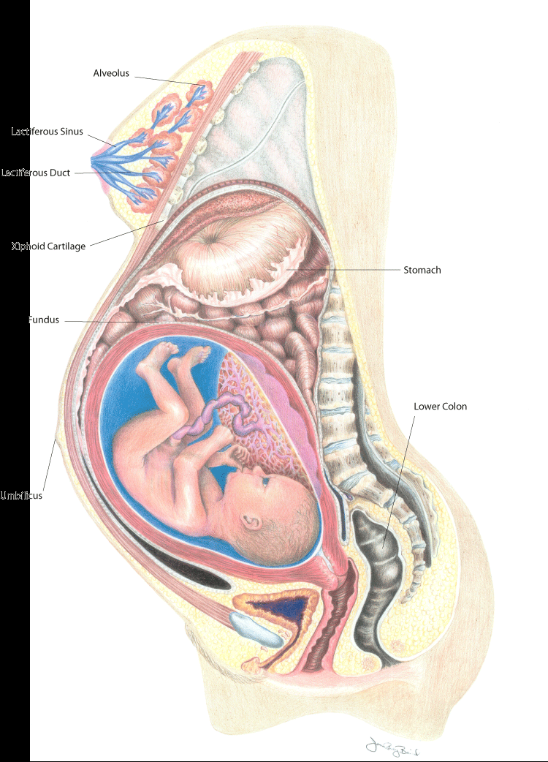

Slide 12
Babies In the Womb
Here you can see a unborn child sucking on a thumb .
Fetus in early stage of development

Slide 13
Uterine Fibroid Tumors
These tumors develop inside the uterus
It is not typical for them to develop inside of a woman who has not yet reached puberty
The reason for this is because they thrive on estrogen
They are the most common pelvic tumor in women

Slide 14
Symptoms and treatment
Symptoms Include:
Bleeding
Pelvic Pain
Discomfort
Vaginal Discomfort
Lower Back Pain
Infertility
Treatments Include:
Surgical Removal
Radiotherapy
Hysterectomy (Removal of the uterus)

Slide 15
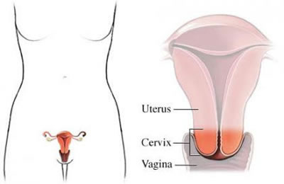
The Cervix
The cervix is the lower most part of the uterus and is located at the upper most part of the vagina. It is composed of strong muscle. The cervix does offer some structural support.

Slide 16
Cervical cancer
Cervical cancer is cancer of the cervical uteri
Most cases are caused by HPV
Symptoms Include:
Vaginal bleeding
Pelvic Pain
Pain During Urination
Unusually Heavy discharge
Cancerous Cervix
Treatment includes Radiotherapy and surgery

Slide 17
The Vagina The Birth Canal
Functions:
During sexual intercourse the vagina receives a male’s penis, sperm is deposited here.
During child birth the vagina acts as a birth canal

Slide 18
Other Activities
Sexual Intercourse
During Sexual Intercourse the walls of the vagina secrete a natural lubricant . The Bartholin’s Glands also secrete mucus
This further reduces friction that could be caused by sexual activity. The fluid is somewhat acidic
Menstruation
During Menstruation the discarded uterine lining exits the body through the vagina
Child Birth
During child birth the vagina stretches to several times its normal diameter
Most dangers concerning the vagina include STDs

